Slide 1
SMART WIRELESS WATER METER USING IOT

Slide 2
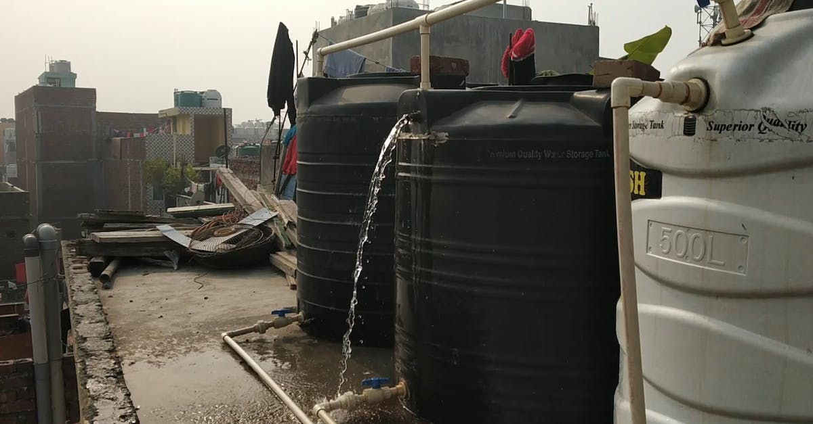
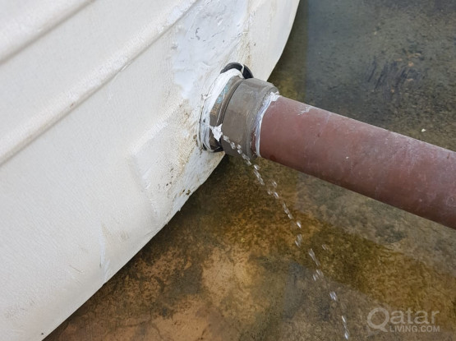
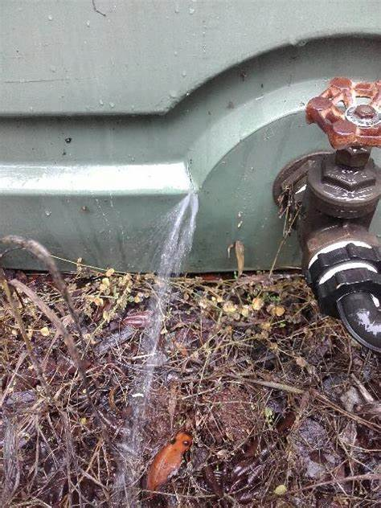
PR0BLEM:Wastage of water
Now a days ,storing of water is a common thing in both rural and urban and business areas because it plays a major role in the day-to-day life.
For storing water everyone focus on two things.
Usage of power
Level of water
So every usually go to water tank and check the level of water. if it is less they will turn on water motor and start fill the tank.in continuous …
In some cases, people will do there work they forgot to turn off the motor even though tank is full and water flowed out ….
This is the major problem facing in almost every homes and Business areas too..
For this problem will invent a smart water level indicator using IOT devices.

Slide 3
Market Potential
85%
68%
78%
People are suffering from this
problem
People are not satisfied with existing solutions
Problem will rectified with our idea

Slide 4
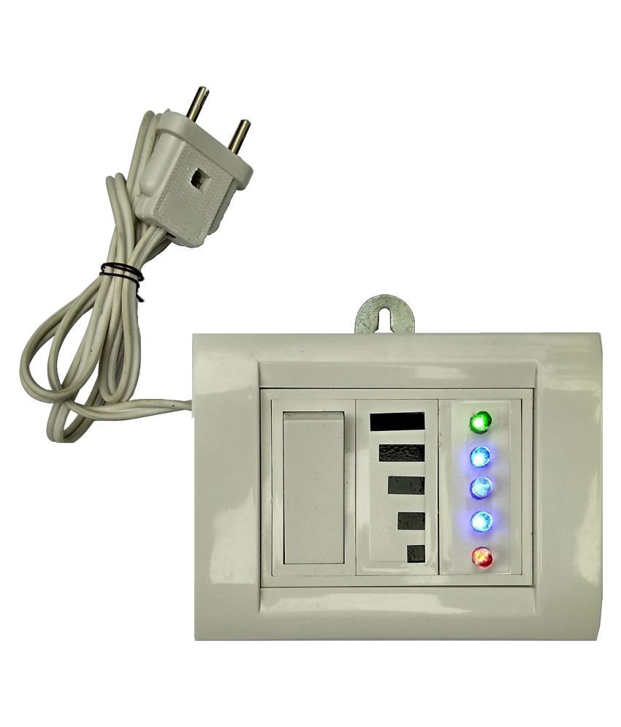
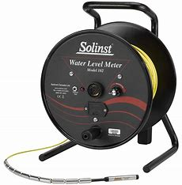
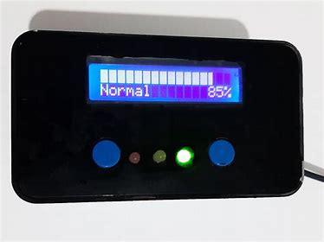
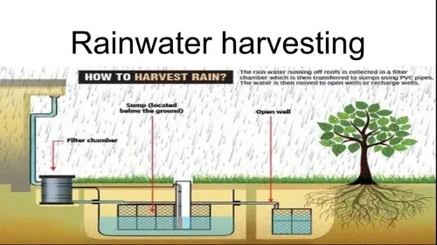
Existing Solution available in the market
Water level indicator with LED indicator
Water level meter
Water level indicator with alarm
Rain Harvesting System
There is several method to save the water….

Slide 5
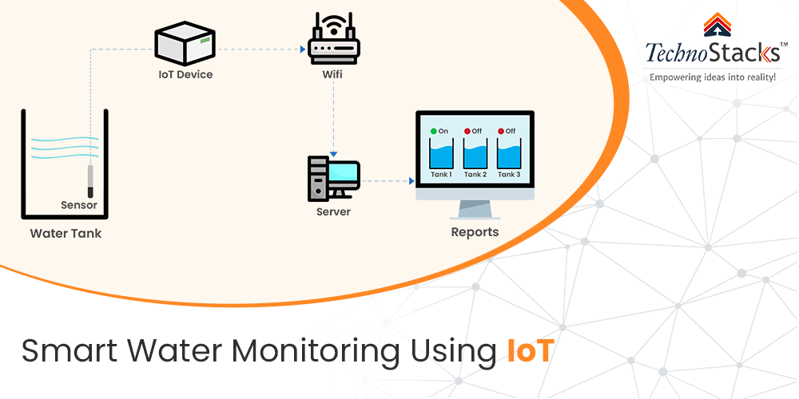
Smart wireless water meter using IOT
Smart wireless water meter using IoT is a revolutionary technology that allows for management of water usage in homes and businesses.
This technology uses sensors and wireless communication to collect data on water consumption
Smart wireless water meters provide an efficient and effective way to manage water resources and reduce waste.

Slide 6
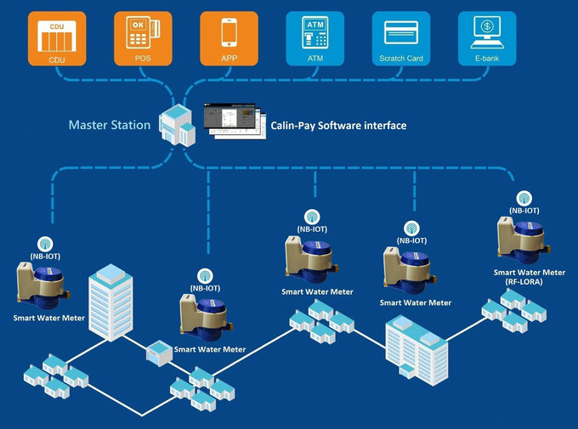
How it works..?
Smart wireless water meters use sensors to measure the flow of water and transmit this data wirelessly to a central server.
The data is then analyzed to identify usage patterns and anomalies, such as leaks or excessive usage.
Users can access this data through a web portal or mobile app, allowing them to monitor their water usage and make adjustments as needed.
In addition to providing real-time monitoring, smart wireless water meters can also be programmed to send alerts when usage exceeds certain thresholds or when leaks are detected.
This helps users to quickly identify and address any issues, reducing water waste and preventing damage to property.

Slide 7
Features
The Smart Water Management
Reduce the amount of wasted water
Reduces cost
Smart Irrigation Controller
IoT Water Valves with Remote Operation Facilities
Practice consumption monitoring
Advanced data analytics
identify leaks and other issues more quickly, reducing water loss and minimizing the need for costly repairs

Slide 8


